Slide 1
5 Standards of Social Studies
8/26 – 8/27

Slide 2
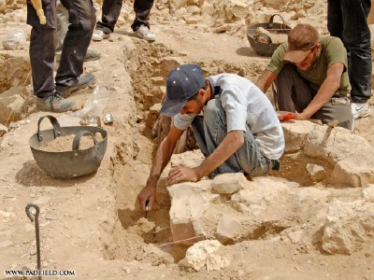
Which Standard?

Slide 3
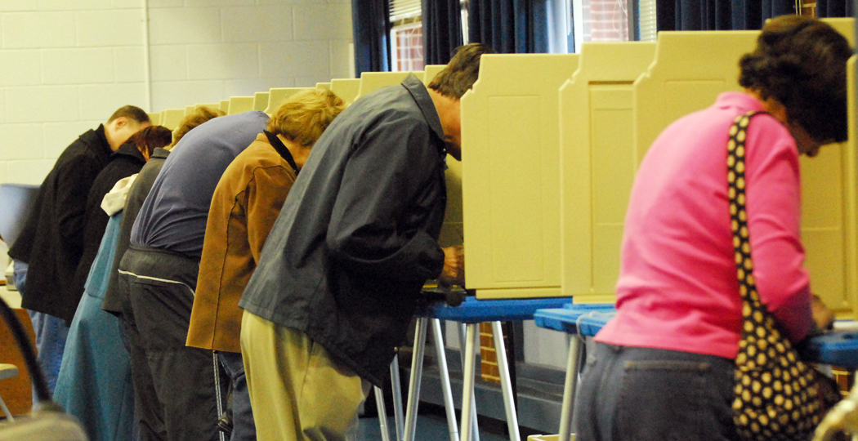
Which Standard?

Slide 4
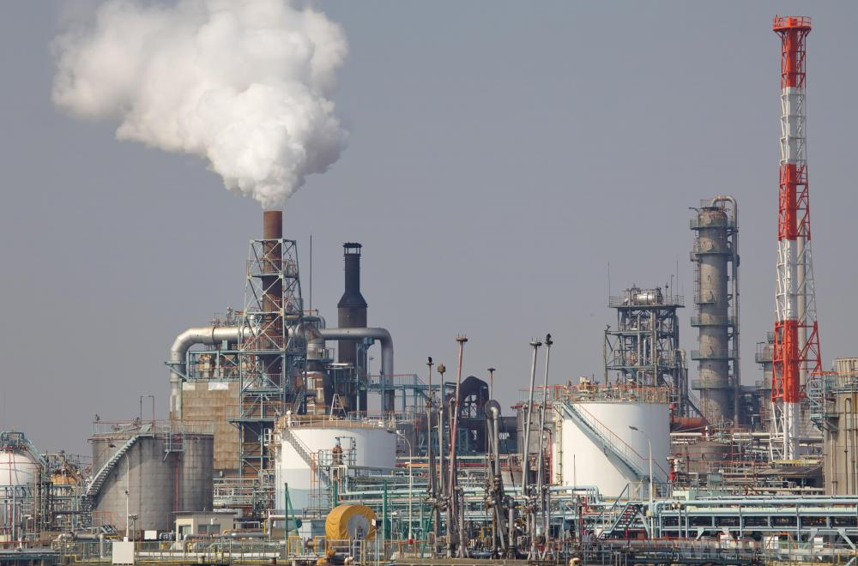
Which Standard?

Slide 5

Which Standard?

Slide 6
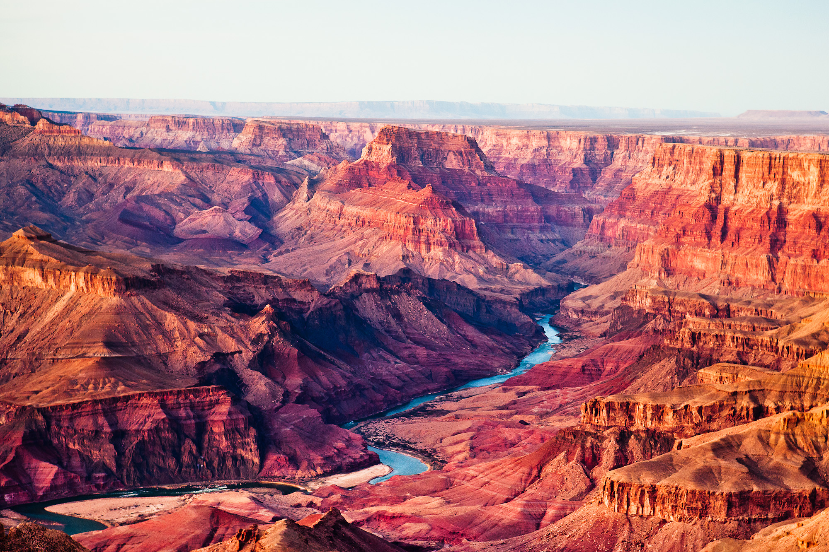
Which Standard?

Slide 7
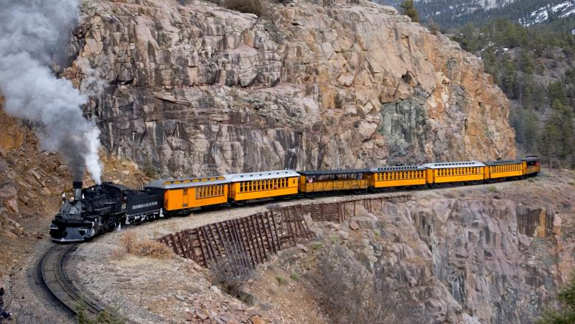
Which Standard?

Slide 8
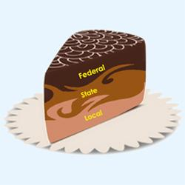
Which Standard?

