Slide 1
Five Themes of Geography
8/26 – 8/27

Slide 2

Which Theme?

Slide 3
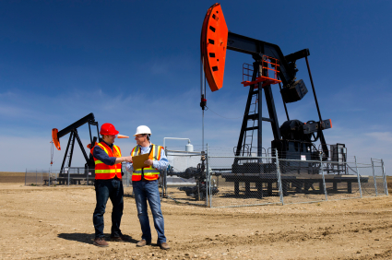
Which Theme?

Slide 4

Which Theme?

Slide 5
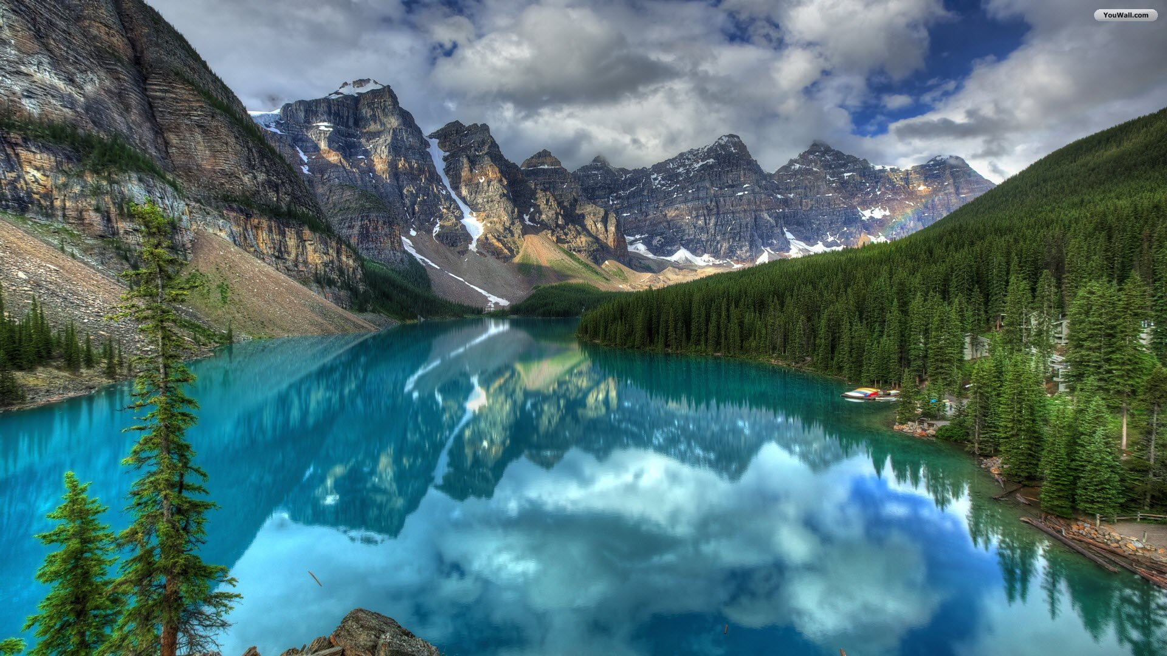
Which Theme?

Slide 6
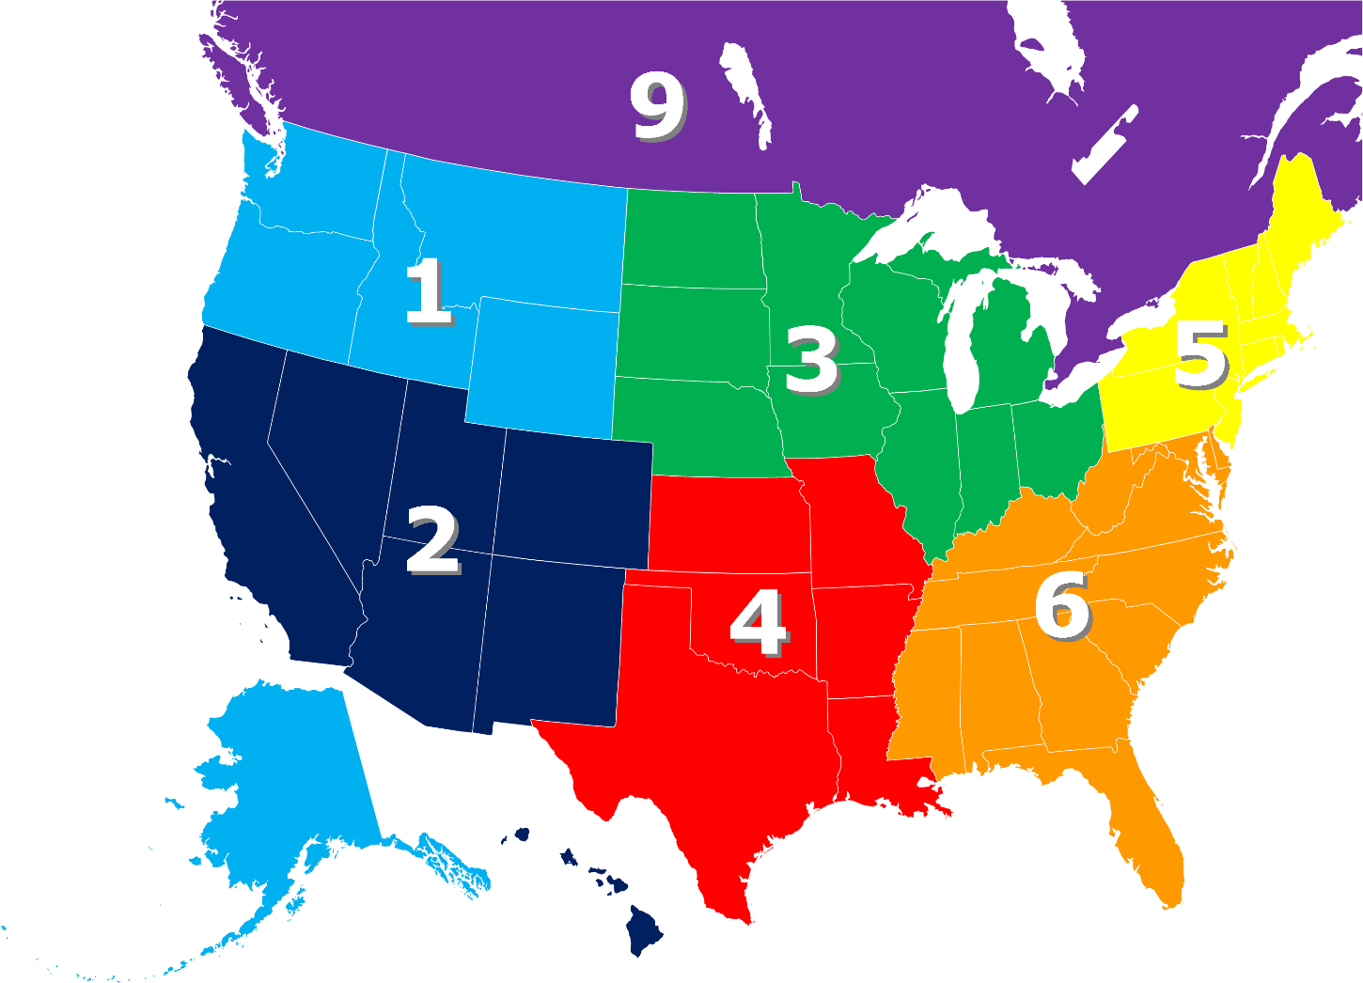
Which Theme?

Slide 7
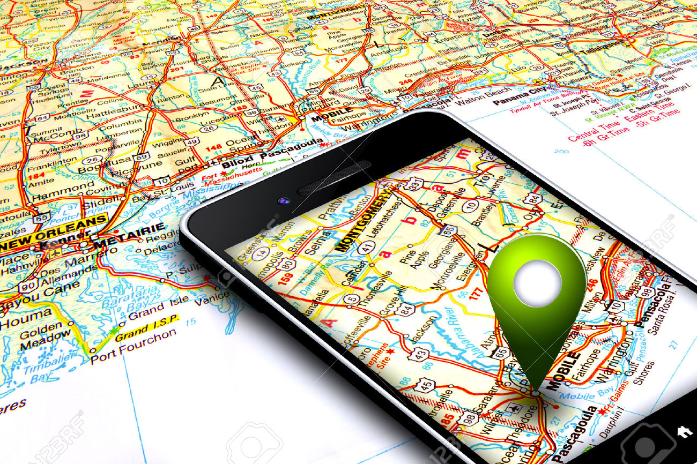
Which Theme?

Slide 8
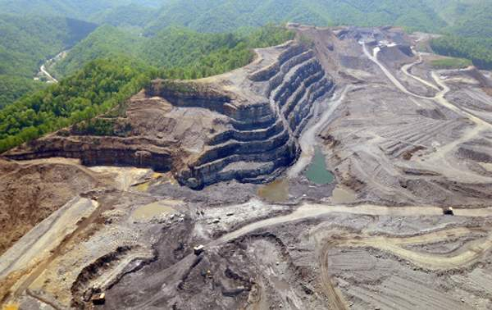
Which Theme?

