Slide 1
Is it Government or Economy?
Choose whether or not it is government or economy based on the pictures or text.

Slide 2
Government or Economics

Slide 3
Government or Economics

Slide 4
Government or Economics
The GDP (Gross Domestic Product) of the United States is around 12.5 trillion a year. The highest in the world!

Slide 5
Government or Economics
King Blazer of planet T7 spent too much money making his planet the premier golf destination in the galaxy. He then decided to raise the taxes on his people to help pay for all of the golf courses he built.

Slide 6
Government or Economics
“In order to attract the Oakland Raiders to Las Vegas leaders casino owners are lobbying for a 2% motel tax in order to pay for a new 1.3 billion dollar stadium”

Slide 7
What type of government?
Identify the type of government based on the picture or text

Slide 8
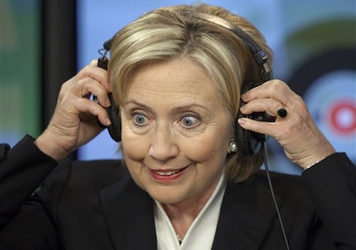
What type of government?
OR

Slide 9
What type of government?
During the early days of the Roman Republic, Rome was ruled by a wealthy group of people called Patricians.

Slide 10
What type of government?

Slide 11
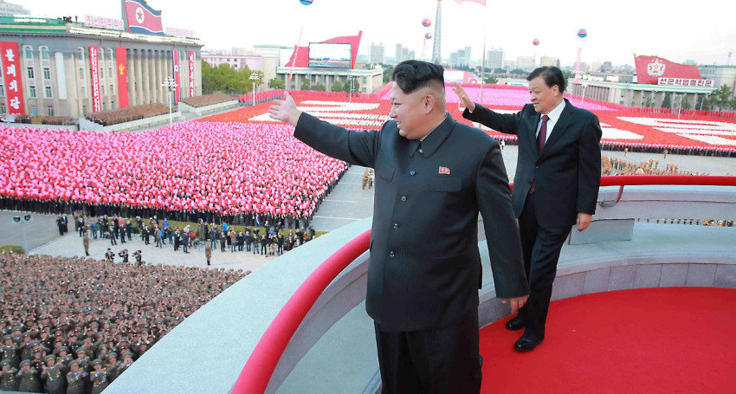
What type of government?

Slide 12
What type of government?
The Chinese government only political party has more than 80m-strong members which makes it the biggest political party in the world. Its tight organization and ruthlessness help explain why it is also still in power.
The party oversees and influences many aspects of people's lives - what they learn at school and watch on TV, even the number of children they are allowed.
It is made up largely of government officials, army officers, farmers, model workers and employees of state-owned companies.
It is unrepresentative of China as a whole. Only a quarter of its members are women, for example. It is also obsessive about control, regularly showing itself capable of great brutality in suppressing dissent or any challenge to its authority.

Slide 13
Which type of Economy?
Choose the type of economy based on the picture or text

Slide 14
What type of economy?

Slide 15
What type of economy?

Slide 16
What type of economy?
I wanted my factory to produce rubber chickens but the Pokémon Political Party leaders told me I had to make Carolina Panther bobble heads instead ☹

Slide 17
What type of economy?
Sam really wanted some of Josie's chicken nuggets at lunch. She said “Josie can I please have some of your chicken nuggets? Pleeeeaaaasssssseeeeeee? Josie said Sam I just cant give my chicken away what do you have to give me? Sam replied I have 9 goldfish, a gogurt, and 2 apple slices. Josie then said for that I will give you three chicken nuggets. Sam agreed and an exchange was then made.

Slide 18
What type of economy?

