Slide 1
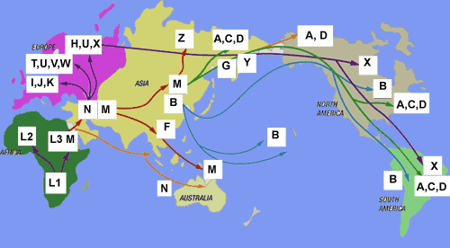
Humans: From Africa to The World

Slide 2
Out of Africa
Scientist believe all humans can be traced back to 2 ancestors in Africa. (the scientific Adam and Eve.)
From Africa humans spread around the world.
At this time oceans levels were lower due to an ice age.

Slide 3
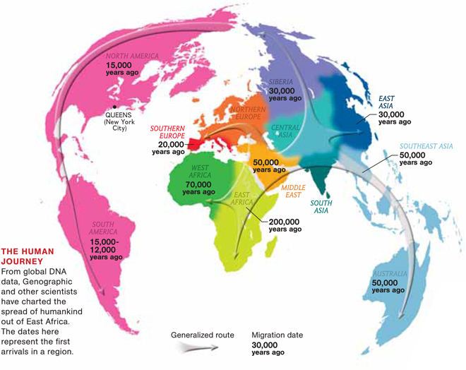
Label each continent and how long ago humans 1st made it to that continent.

Slide 4
Classwork
Create a timeline showing the different times humans made it to the different continents on earth (include all 6 continents.)
200,000 years ago humans first appear in Africa

Slide 5
