Slide 1
Qin, Han, or Zhou?
January 2016

Slide 2
Qin, Han, or Zhou?
United China into one kingdom

Slide 4
Qin, Han, or Zhou?
Instituted Civil Service

Slide 6
Qin, Han, or Zhou?
Developed Paper

Slide 8
Qin, Han, or Zhou?
Developed Confucianism, Daoism, and Legalism

Slide 9
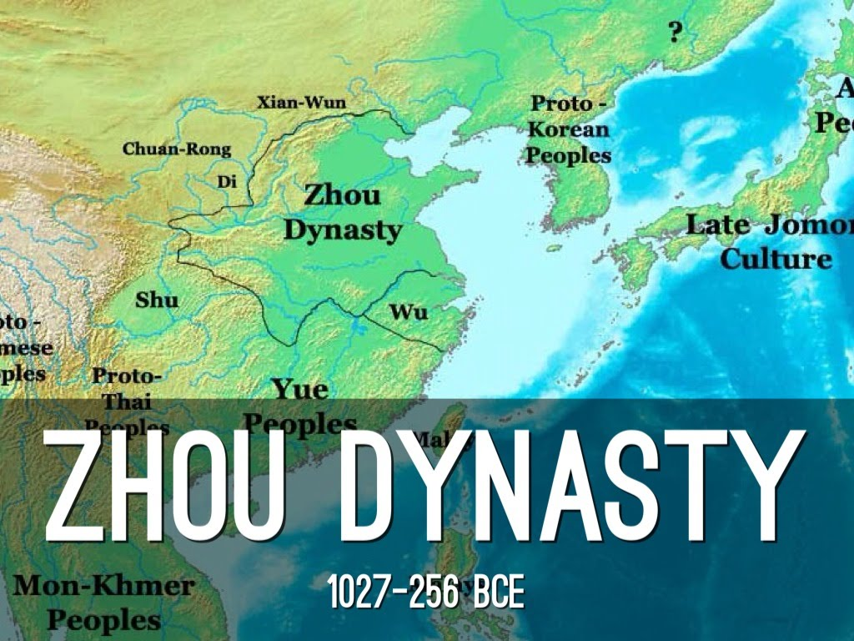

Slide 10
Qin, Han, or Zhou?
Standardized Currency, axel lengths, and measurements

Slide 12
Qin, Han, or Zhou?
Longest lasting dynasty

Slide 14
Qin, Han, or Zhou?
Established the Silk Road

Slide 16
Qin, Han, or Zhou?
Developed Iron tools and weapons

Slide 18
Qin, Han, or Zhou?
Emperor created a magnificent tomb that included terracotta warriors

Slide 20
Qin, Han, or Zhou?
Emperor Wu, the 7th ruler of this dynasty ruled China for 54 years, increasing its territory to its largest in Chinese history.

