Slide 1
Welcome to 6th grade social studies!!
8.29/30.16

Slide 2
What are we studying
World history from pre-history (cavemen) to Exploration ( Columbus, Cortez, etc.) including five major religions and Geography.
1st Quarter: Geography, world religions, and begin pre-history
2nd Quarter: Pre-History and Ancient River valley civilizations
3rd Quarter: Classical Civilizations (West African, Greece, and Rome)
4th Quarter: Middle Ages, Mesoamerica, and Exploration

Slide 3
Grading Policy
Formal 65% (tests, major projects)
Informal 35% (quizzes, classwork)
Formal grades can be made up…
Informal grades are graded on a 100% scale if turned in on time
80% scale for 1 day late
50 % scale for 2 or more days late

Slide 4
Grade Scale
A: 90-100
B: 80-89
C: 70-79
D: 60-69
F < 59

Slide 5
Lockers
Lockers are available for a small fee but it is not something that you will need to use on a regular basis

Slide 6
Expectations

Slide 7
Morning routine (1A & 1B only)
When you arrive in the morning please have a seat and get ready for the day.
If you need to get caught up on classwork and or need to go see another teacher now is the time.
At 8:05 we will begin our warm-up activity.
At 8:15 the announcements come on and you are expected to be silent
After the conclusion of the announcements we will begin class

Slide 8
Materials You need to bring to class everyday
Pencil
Notebook
Chrome book
Tape
Headphones

Slide 9
Entering and Exiting the classroom
When you enter the classroom you need to enter from the left hand side door.
When you exit the classroom you need to exit from the right hand side door.

Slide 10
Chrome books
Chrome books are a privilege, NOT A RIGHT!!!!!!
If you are caught playing a game or other off task behavior your Chromebook will be taken away and you will be given a paper copy of the assignment
If you are constantly getting caught abusing your Chromebook you will not be allowed to use it for an indefinite period of time.

Slide 11
Lunch (3A & 3B only)
Once you are silent and the class is dismissed you will quietly line up at the end of the ramp.
From there we will walk to the front of the building stopping just short of the awning.
We will then line up quietly in a straight line and we will not speak and or make noises until we are inside the lunch room
We will maintain our straight line until inside the lunch room.
Once inside the lunch room we will sit at our designated tables except on Miner Fridays.
When we leave the lunchroom you must make sure that there is no trash on the floor or around the tables
We will then line up by the double doors at the end of the hall. We will be silent in the building and when we are walking towards the bus lot.

Slide 12
Cell Phones
Cell Phones are not allowed to be out and they should be kept out of sight
Headphones apply under this rule as well unless we are working on an activity that requires there usage

Slide 13
Extra Credit
Do you have any extra credit?
NOPE
But I do have opportunities to earn bonus point cards through various games we will play throughout the year

Slide 14
Fun things about Mint Hill

Slide 15
Clubs (HR only)
Clubs are held during Refinery time (9:40 – 10:10)
Clubs are typically MT (Monday, Tuesday) and WR Wednesday, Thursday)
Fridays will be used for a still undetermined activity

Slide 16
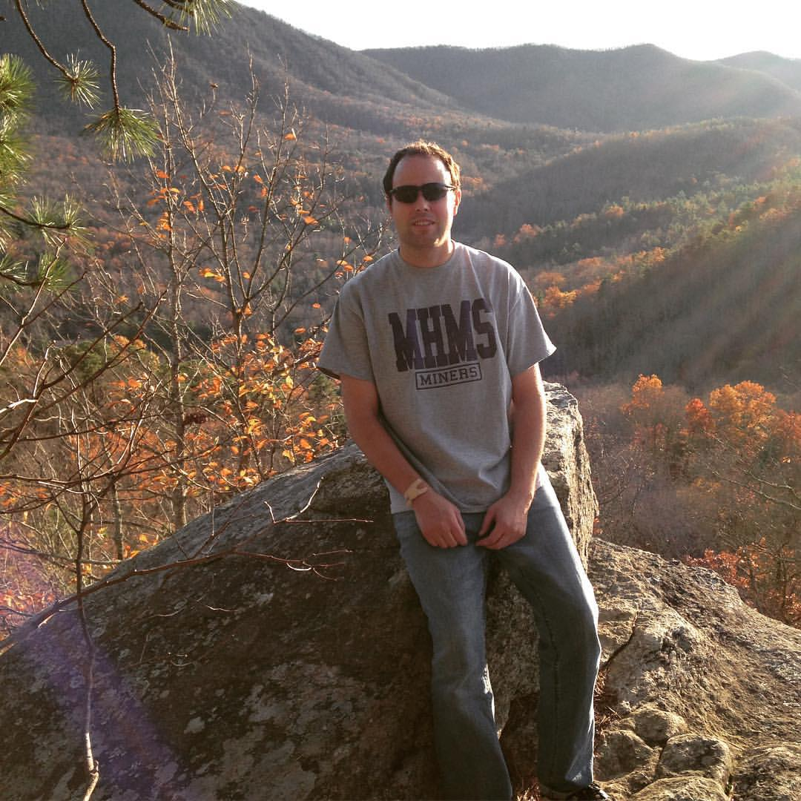
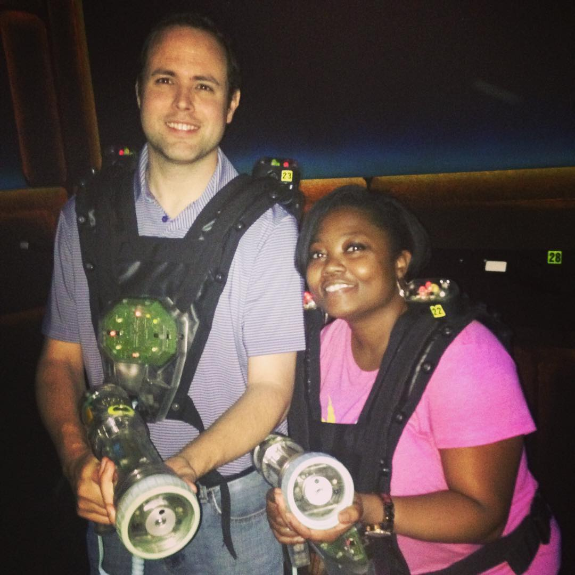
Field Trips
Camp Kanuga
Laser Tag

Slide 17
Fun Friday (Just my class)
We will try to have Fun Fridays for the last 20 minutes or so of the class.
FF is either free time on your chrome books or time to quietly socialize (3 ft. rule)
No cellphones ☹
Fun Friday is a reward for people who are working hard and following my expectations
There is no moving around the room on FF
People who have numerous missing assignments will need to take this time to complete the work that they are missing.

Slide 18
Questions?
Does anyone have any questions?

